Slide 1
Introduction to Natural Language Processing with Tensorflow
Week 10, Day 3

Slide 2
Natural Language Processing (NLP)
Natural Language Processing, NLP refers to a field in computer science that deals with the interaction between computer and human languages. NLP aims at allowing computers to interpret human linguistics at various levels.
NLP is broadly classified into the following:
Natural language understanding: NLU deals with understanding a given text and interpreting its meaning. It converts human language into a structured format that is usable by a computer.
Natural language generation: NLG deals with generating a Natural Language from the available amount of textual data. It involves making sentences that are understood by a human.

Slide 3
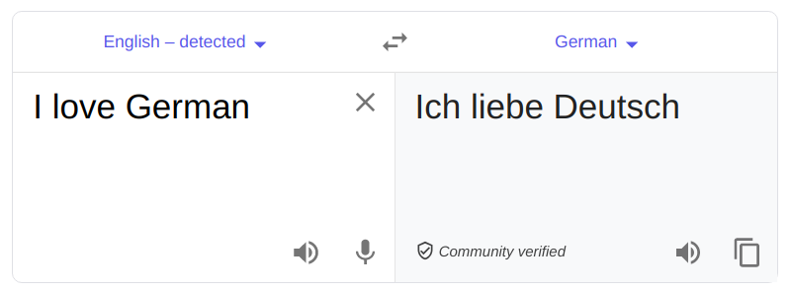
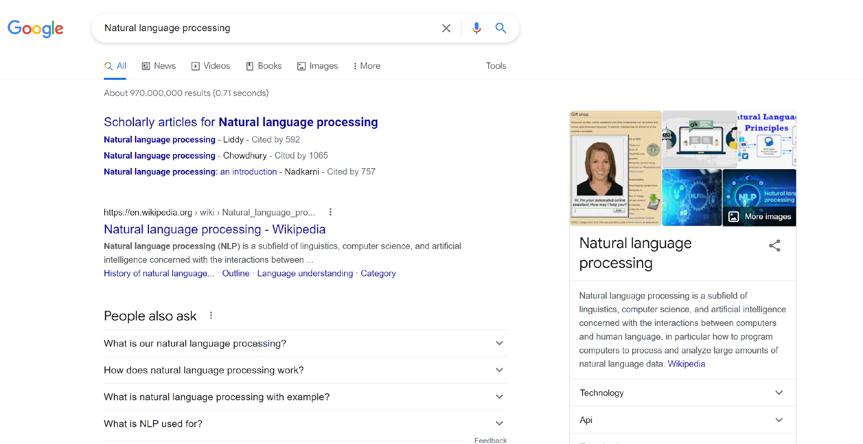
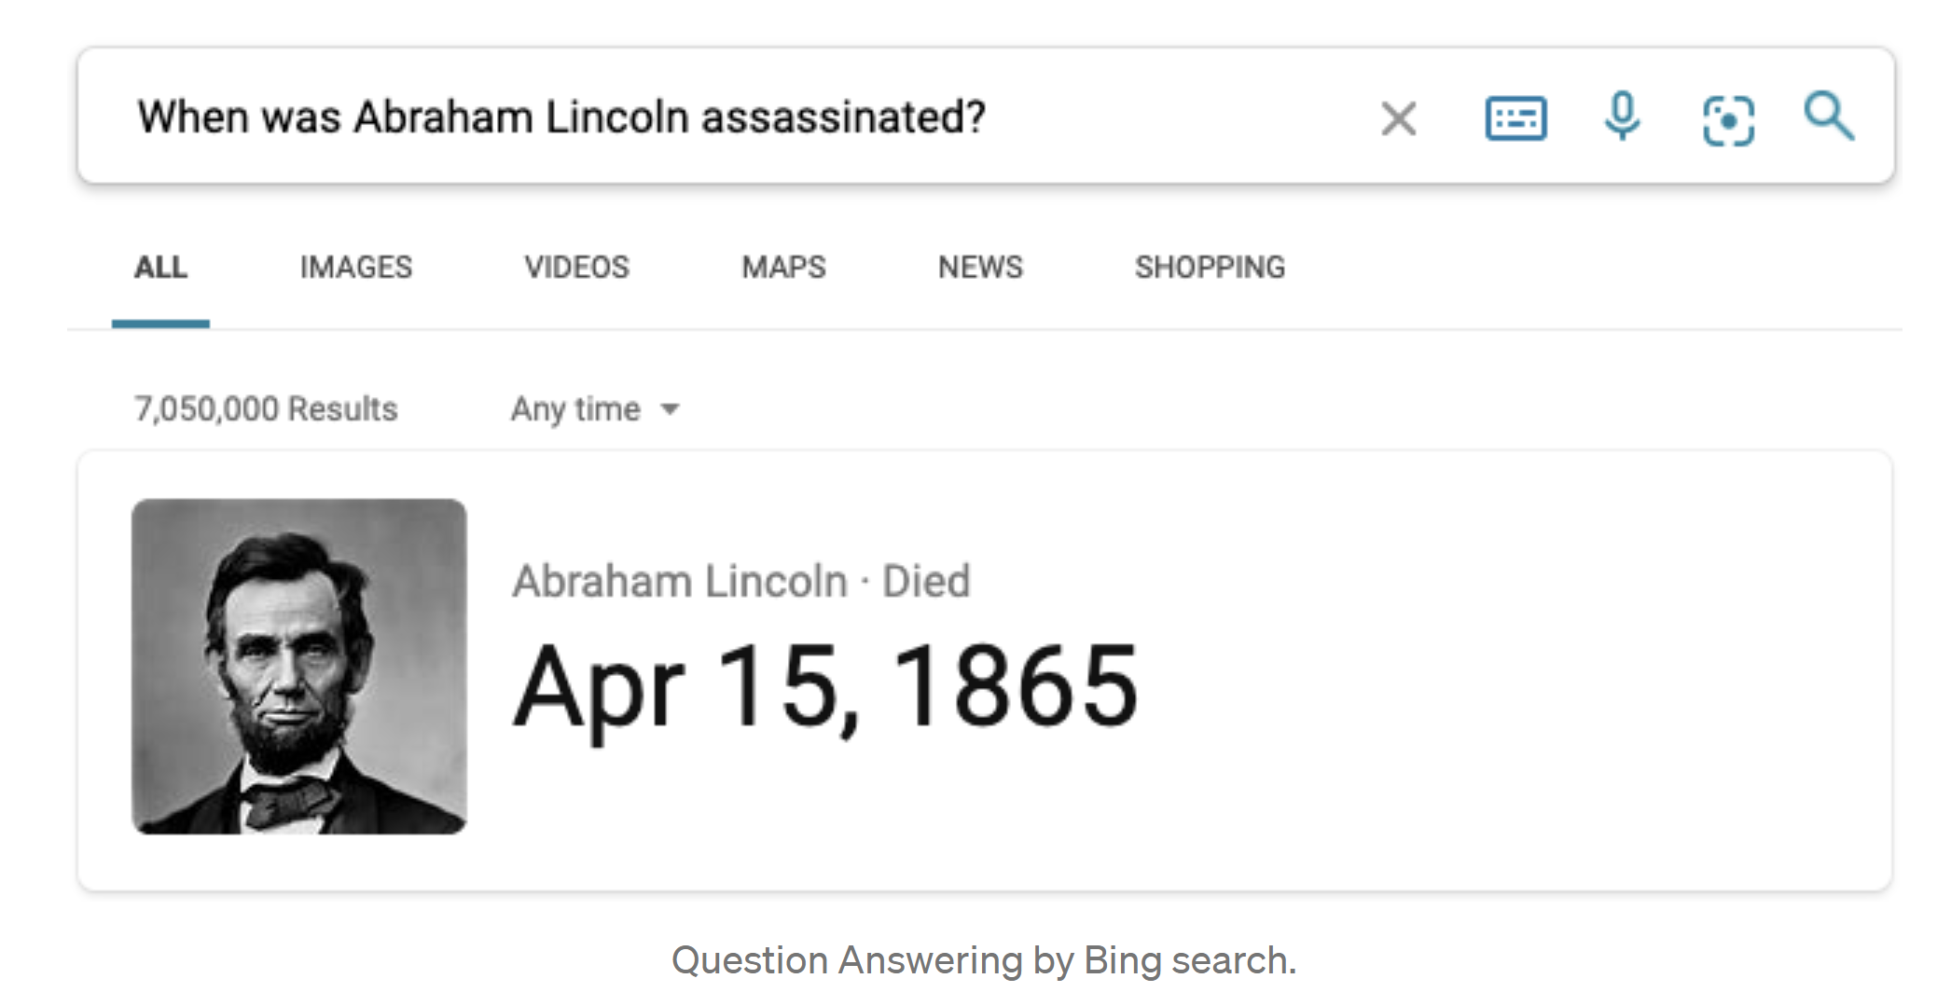
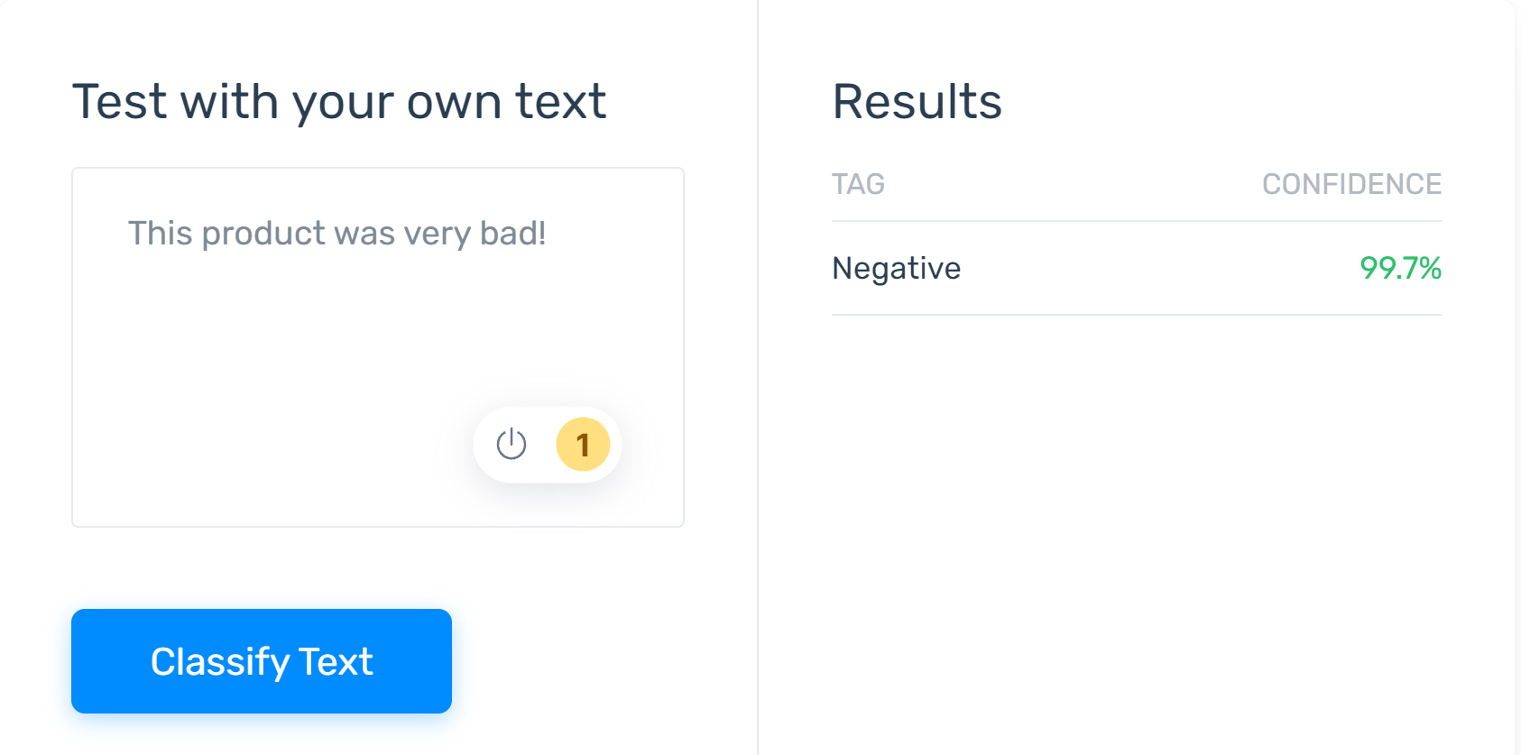
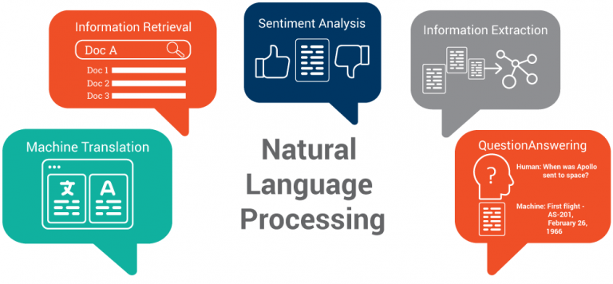
Information Retrieval
Machine Translation
Question Answering
Sentiment Analysis
Notes:
Machine Translation is the procedure of automatically converting the text in one language to another language while keeping the meaning intact.
Question Answering(QA) system is a system that gives appropriate answers to questions expressed in natural languages such as English, Chinese, and so on.
Sentiment analysis, is a technique to recognize subtle nuances in emotions and opinions from text ‒ and determine how positive or negative they are.
Information retrieval is defined as the process of accessing and retrieving the most appropriate information from text based on a particular query given by the user, with the help of context-based indexing or metadata.

Slide 4
Deep Learning Pipeline
Step 1
Step 2
Step 3
Step 4
Step 5
Load and Preprocess Data
Data Visualization
Design the Deep Learning Model
Train the Model
Define
Evaluate the Model
Deep Learning Training Process
Weights are randomly initialized in the beginning
We know the actual labels
Model.compile -> define the loss function, optimizer
Model.fit -> does all the steps below.
Input data -> Batch of data = 64 data samples
We find the predictions.
We pass the predictions to optimizer (optimizer already knows what the actual labels are.)
We find the loss between predicted labels and actual labels.
We tune the “learnable” parameters according to the loss.
Go back to step 1.
You can try this service from here: Semantic Analysis

Slide 5
Step 1: Load and Preprocess Data
https://www.tensorflow.org/api_docs/python/tf/keras/layers/TextVectorization
Textual data is usually preprocessed using the following 5 tasks:
Standardize each example (usually lowercasing + punctuation stripping)
Split each example into substrings (usually words)
Recombine substrings into tokens (usually ngrams)
Index tokens (associate a unique int value with each token)
Transform each example using this index, either into a vector of ints or a dense float vector.
Yes it was a little low budget, but this movie shows love!
[yes it was a little low budget but this movie shows love]
[yes, it, was, a, little, low, budget, but, this, movie, shows, love]
Standardization refers to preprocessing the text, typically to remove punctuation or HTML elements to simplify the dataset.
Tokenization refers to splitting strings into tokens (for example, splitting a sentence into individual words by splitting on whitespace).
Vectorization refers to converting tokens into numbers so they can be fed into a neural network.
Bag of Words
414 9 10 192 20 25. 200 200. 250 300. 96 20 0 0 0 0 0 0 …
Max_length

Slide 6
Input sentence
label
Yes it was a little low budget, but this movie shows love!
1
Text Encoder
- Vocabulary (** 1000 words ) – VOCAB SIZE

Slide 7
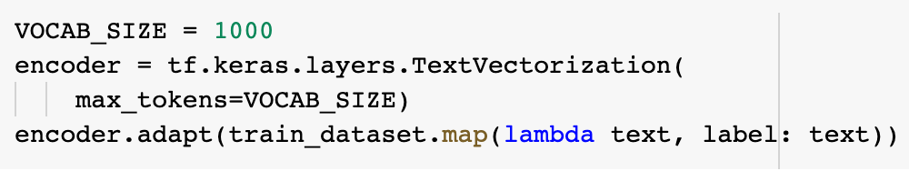

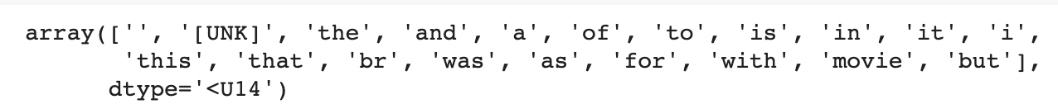
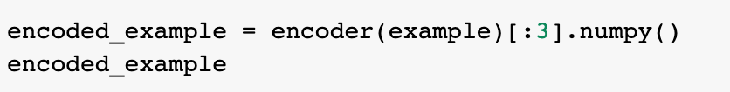
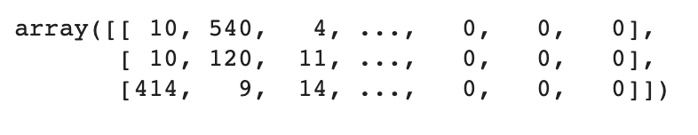
Step 1: Load and Preprocess Data
Vocabulary
Encoded sentence
https://www.tensorflow.org/api_docs/python/tf/keras/layers/TextVectorization

Slide 8
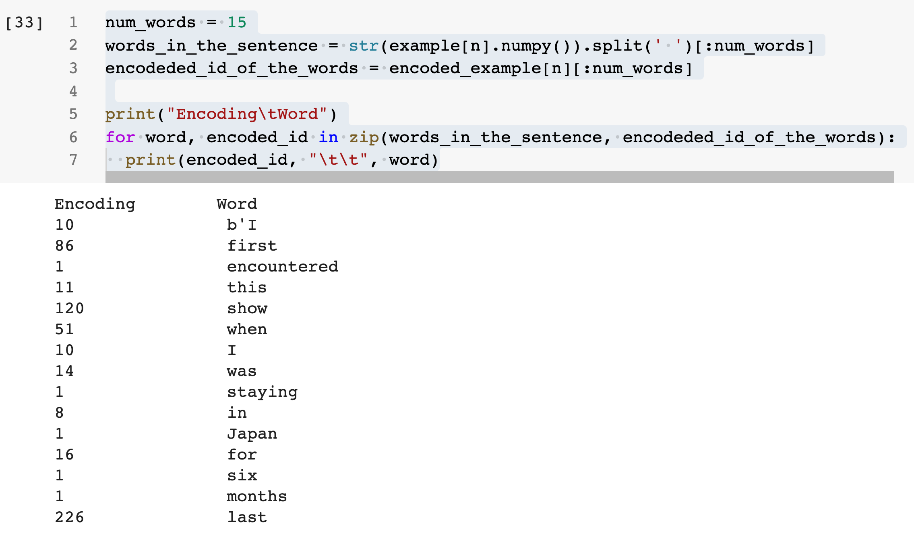
Step 2: Visualize the dataset
1000 VOCAB SIZE
Word Count or Bag of Words

Slide 9
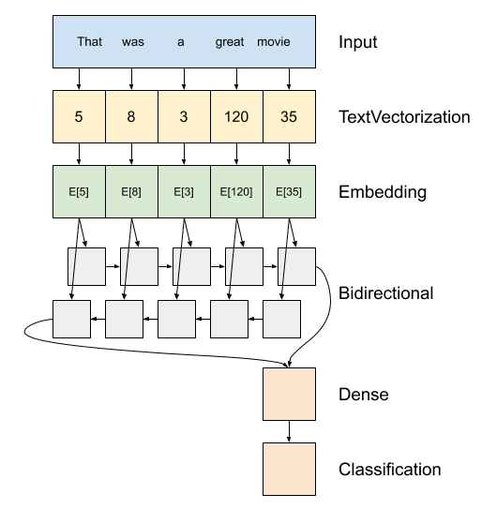
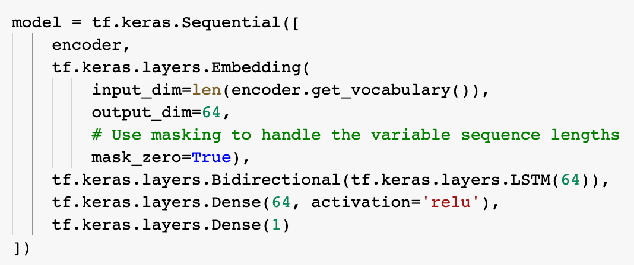
Step 3: Design the NLP Model
RNN – Recurrent Neural Network
“the chicken is ready to eat”
bad = 120
1x64 [………..] [………..] [………..] [………..] [………..]
That
was
1
2
3
4
5
1
2
3
4
5
The output of the Bidirectional RNN is passed to a Dense layer with 64 nodes, and then further passed to the output layer for final binary classification.
2nd word is processed based on the embedding at 2nd location in sentence as well as the output of the first word..
3rd word is processed based on the embedding at the 3rd loc in the sentence as well as the output of the second word.
64
0/1
Word2Vec – Package by Google to create Embeddings.

Slide 10
LSTM – Long Short-term Memory
GRU – Gated Recurrent Unit
A priest who has abandoned his ministry meets a young man who has just been ordained. This movie is about the cruel dilemma between a life dedicated to God and faith and a life of more earthly pleasures. In post war France it is also about the mortal aspect of Faith itself. This may not be the movie of a lifetime but it is a sin to have allowed it to fall in oblivion. Besides, Pierre Fresnay is sublime.
Input =
Label = 0

Slide 11
Deep Learning Training Process
Weights are randomly initialized in the beginning
We know the actual labels
Input data -> Batch of data = 64 data samples
We find the predictions.
We pass the predictions to optimizer (optimizer already knows what the actual labels are.)
We find the loss between predicted labels and actual labels.
We tune the “learnable” parameters according to the loss.
Go back to step 1.
bad = 120
Tune all trainable parameters
“Learnable” Parameter
1x64 [………..] [………..] [………..] [………..] [………..]
1
or “trainable”
1
2
3
4
5
Output Labels
Learnable Parameter
LOSS Fn
Cross Entropy
1
2
3
4
5
Optimizer - Adam
Minimize
GOAL
64
Learnable Parameter
Output Prediction
0 – 90% -> loss is high -> tune parameters
1 – 50% -> tune parameters again
1 – 90% -> ok, stop.
0/1
Learnable Parameter

Slide 12
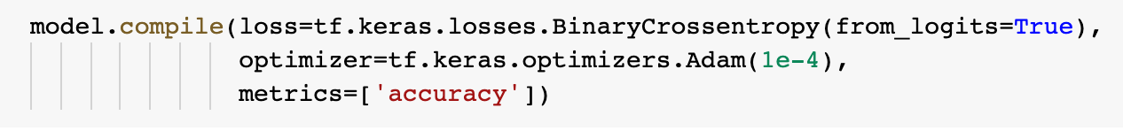
Step 4: Train the NLP Model
Once we have defined the model, now we can compile the model with the loss and optimizer functions just like we did for the DNN and CNN examples last week. We can then fit the model on the train dataset to train the embedding layer, RNN, and dense layers. Note that the RNN layer has multiple layers inside which enables the temporal or sequential nature of learning. The overall parameters of the model is thus dependent on the embedding size, number and size of RNN layers, and the number and size of dense layers.

Slide 13
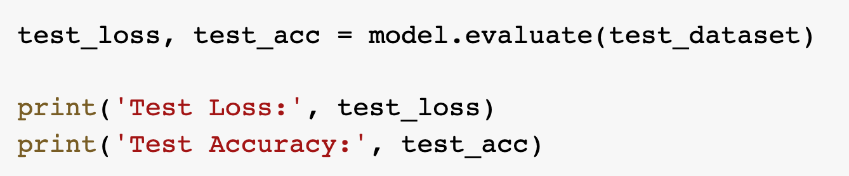
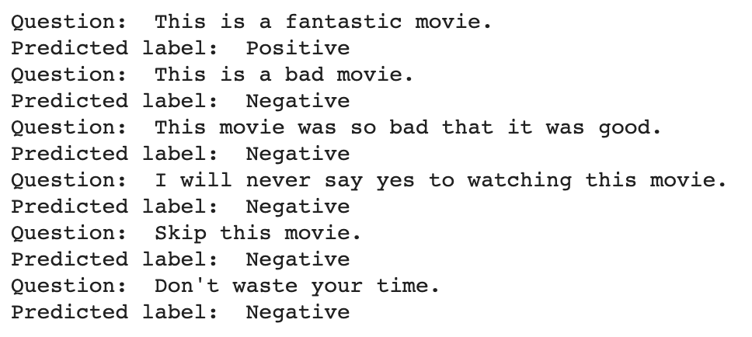
Step 5: Evaluate the Trained Model
We can run evaluate method on the model to find the test loss and accuracy.
Now, given a new input, we can understand if a movie review is positive or negative.
We can now experiment by adding multiple RNN layers to the network and trying out different types of RNN layers.

Slide 14
Additional Information

Slide 15
NLP Application: Information Retrieval
Information retrieval is defined as the process of accessing and retrieving the most appropriate information from text based on a particular query given by the user, with the help of context-based indexing or metadata.
Google Search is the most famous example of information retrieval.
An information retrieval system searches a collection of natural language documents with the goal of retrieving exactly the set of documents that matches a user’s question. They have their origin in library systems.

Slide 16
NLP Application: Machine Translation
Machine Translation is the procedure of automatically converting the text in one language to another language while keeping the meaning intact.
In earlier days, machine translation systems were dictionary-based and rule-based systems, and they saw very limited success. However, due to evolution in the field of Deep Learning and NLP, availability of humongous data, and powerful machines, machine translation has become fairly accurate in converting the text from one language to another.

Slide 17
NLP Application: Sentiment Analysis
Natural language understanding is particularly difficult for machines when it comes to opinions, given that humans often use sarcasm and irony. Sentiment analysis, however, is able to recognize subtle nuances in emotions and opinions ‒ and determine how positive or negative they are.
You can try this service from here: Semantic Analysis

Slide 18
NLP Application: Question Answering
Question Answering(QA) system is a system that gives appropriate answers to questions expressed in natural languages such as English, Chinese, and so on. For example, suppose a user asks “When was Abraham Lincoln assassinated?” In this case, the question answering system is expected to return “Apr 15, 1865”.
A question answering system will help you find information efficiently. Generally speaking, we use search engines to search for relevant documents when we look for some information on the Web. However, because they show you documents, you must read the documents and decide whether they contain the information you need. It’s a bother. Thus, commercial search engines have a question answering feature so that you can find information efficiently.

Slide 19
Terminology
https://developers.google.com/machine-learning/glossary
Batch | The set of examples used in one iteration (that is, one gradient update) of model training.
Batch size | The number of examples in each batch.
Epoch | The number of times we cover the entire dataset during training. Steps in each epoch = Total samples / batch size.
Activation function | A function (for example, ReLU or sigmoid) that takes in the weighted sum of all of the inputs from the previous layer and then generates and passes an output value (typically nonlinear) to the next layer.
Iteration | A single update of a model's weights during training. An iteration consists of computing the gradients of the parameters with respect to the loss on a single batch of data.
Dense or Fully Connected Layer | A hidden layer in which each node is connected to every node in the subsequent hidden layer.
Generalization | Refers to your model's ability to make correct predictions on new, previously unseen data as opposed to the data used to train the model.
Hidden Layer | A synthetic layer in a neural network between the input layer (that is, the features) and the output layer (the prediction). Hidden layers typically contain an activation function (such as ReLU) for training.

